Slide 1
Filter
Name | Dharini Baskaran
Identity Key | dhba5060
 | Level | Completed
 | Beginner | 11
 | Intermediate | 5
 | Advanced | 1
 | Expert | 0
Goal
4722 | 13
5722 | 15
Total Completed
17

Slide 2
Filter
CSCI 5722/4722: Computer Vision
Spring 2024
Dr. Tom Yeh
Dr. Mehdi Moghari

Slide 3
1D Filters

Slide 4
1D Signal
I[i]
1 | 4 | 5 | -2 | 3 | 7 | 9 | 6 | 8 | -1 | 2

Slide 5
Element-wise Operation
I[i]
1 | 4 | 5 | -2 | 3 | 7 | 9 | 6 | 8 | -1 | 2
*
2
 |  |  |  |  |  | 18 | 12 | 16 | -2 | 4

Slide 6
Cross Correlation
I[i]
1 | 4 | 5 | -2 | 3 | 7 | 9 | 6 | 8 | -1 | 2
H[u]
1 | 0 | -1
1 | 0 | -1

Slide 7
Neighborhood
1 | 4 | 5 | -2 | 3 | 7 | 9 | 6 | 8 | -1 | 2

Slide 8


Neighborhood
Neighbor
a
b
2 to the left
7 | 3 | 2 | 4 | 0 | 0 | 7 | 3 | 2 | 4 | 0
2 to the right
c
🔑 Σa = 7; Σb = 7; Σc = 12

Slide 9
Cross Correlation as Matrix Multiplication
Neighbor
L1
C
1 | 4 | 5 | 2 | 3 | 7 | 9
R1

Slide 10





Box filter
pad with -1
Neighbor
L1
-1 | 2 |  |  |  | 3 | 1
C
2 | 1 | 0 | 2 | 3 | 1 | 0
R2
0 | 2 |  |  |  | -1 | -1
a
0 | 3 |  |  |  |  | 0
b
c
🔑 sum(a) = 3; sum(b) = 7; sum(c) = 7

Slide 11

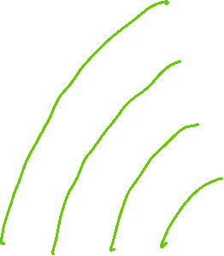




Mean filter
pad with 0
L1
C
4 | 8 | 0 | 4 | 0 | 0 | 4
R1
8 | 0 | 4 | 0 | 0 | 4 | 0
R2
0 | 4 | 0 | 0 | 4 | 0 | 0
a
 |  |  |  | 2 | 1 | 1
b
c
🔑 sum(a) = 1; sum(b) = 7; sum(c) = 4

Slide 12
Up or Down?
L
C
R
X | 1 | 2 | 6 | 8 | 12 | 7 | 5 | 2 | -2
1 | 4 | 6 | 8 | 12 | 7 | 5 | 2 | -2 | -5
4 | 6 | 8 | 12 | 7 | 5 | 2 | -2 | -5 | X

Slide 13
Math: Cross-Correlation $H⨂F$
0 | 1 | 4 | 5 | 2 | 3 | 7
L
I[i]
1 | 4 | 5 | 2 | 3 | 7 | 9
C
4 | 5 | 2 | 3 | 7 | 9 | 0
R
H[u]
1 | -1 | 0

Slide 14
Math: Convolution $H∗F$
0 | 1 | 4 | 5 | 2 | 3 | 7
L
I[i]
1 | 4 | 5 | 2 | 3 | 7 | 9
C
4 | 5 | 2 | 3 | 7 | 9 | 0
R
H[u]
1 | -1 | 0
0 | -1 | 1

Slide 15
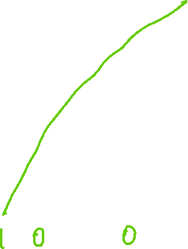



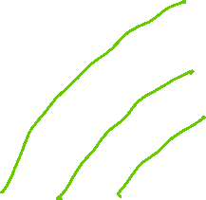



Cross Correlation $⨂$ vs. Convolution $∗$
H[u]
0 | 1 | 2 | 0 | 2 | 1 | 0
L1
1 | 0 | -1 | 0
I[i]
1 | 2 | 0 | 2 | 1 | 0 | 2
C
2 | 0 | 2 | 1 | 0 | 2 | 0
R1
0 | 2 | 1 | 0 | 2 | 0 | 0
R2
a
-2 | 1 |  |  |  | -1 | 0
$H⨂I$
-1 | 0 |  |  |  | 0 | -2
$H∗I$
b
🔑 sum(a) = 1; sum(b) = 0

Slide 16

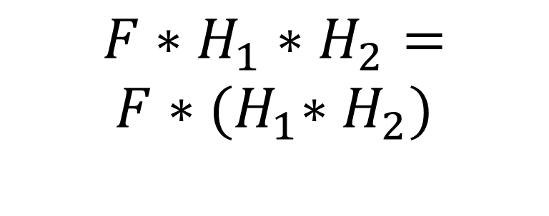
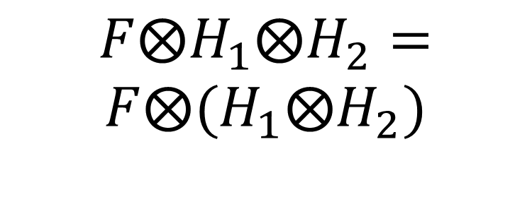
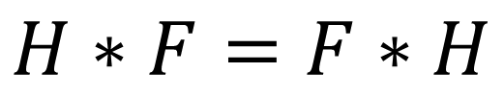
Properties
$$H⨂F=F⨂H$$
$$H∗F=F∗H$$
$$F⨂H_{1}⨂H_{2}=$$
$$F⨂{(H}_{1}⨂H_{2})$$
$$F∗H_{1}∗H_{2}=$$
$$F∗{(H}_{1}∗H_{2})$$

Slide 17
Multiple Channels

Slide 18
Color: floating value representation
Red
Range: [0, 1]
Green
Range: [0, 1]
Blue
Range: [0, 1]

Slide 19
RGB → Grayscale
Red
1 | 1 | 0 | 0 | 1 | 0
Range: [0, 1]
Green
0 | 1 | 0 | 1 | 1 | 1
Range: [0, 1]
Blue
0 | 0 | 0 | 1 | 1 | 0
Range: [0, 1]

Slide 20
RGB: Float → Integer
Red
1 | 1 | 0 | 0 | 1 | 0
Range: [0, 1]
Green
0 | 1 | 0 | 1 | 1 | 1
Blue
0 | 0 | 0 | 1 | 1 | 0
.*
Red
Range: [0, 255]
Green
Blue

Slide 21
Scaling 1D Filtering

Slide 22
Single Channel
0 | 1 | 2 | 3
1 | 2 | 3
2 | 3
1 | 1 | 0
0 | 1 | 1

Slide 23
Two Channels
0 |  | -1
 | -1
-1
0 | 1 | 2 | 3
1 | 2 | 3
2 | 3
0 | 0 | 1
1 | 0 | 0
1 | 1 | 0
0 | 0 | 1

Slide 24
Add One Channel

Slide 25
Add One Filter

Slide 26
Add One Neighbor

Slide 27
Add One Input

Slide 28
Add 1 Neighbor
Copy, add rows and columns
Show your work
Number of new cells added = ___________

Slide 29








Add 1 Channel
Copy, add rows and columns
Show your work
a
Number of new cells added = ___________
🔑 a % 4 = 2

Slide 30







Add 1 Neighbor + 1 Filter
Copy, add rows and columns
Show your work
a
Number of new cells added = ___________
🔑 a % 6 = 2

Slide 31






Add 2 inputs
Copy, add rows and columns
Show your work
a
Number of new cells added = ___________
🔑 a % 3 = 1

Slide 32







Scale to 2 channels, 3 filters
X
Copy, add rows and columns
Show your work
a
b
shape(K) = (______, _______)
shape(X) = (______, _______)
shape(Z) = (______, _______)
K
Z
🔑 sum(a)=12; sum(b)=14

Slide 33















Scale to 4 channels, 5 filters, 6 inputs
X
Copy, add rows and columns
Show your work
a
b
shape(K) = (______, _______)
shape(X) = (______, _______)
shape(Z) = (______, _______)
K
Z
🔑 sum(a)=22; sum(b)=24

Slide 34
2D Filters

Slide 35
Flatten
0 | 2 | 3 | 0
0 | 0 | 4 | 0
3 | 5 | 0 | 0
0 | 0 | 9 | 2
6 | 0 | 0 | 0
 |  |  |  |  |  |  |  |  |  |  |  | 0 | 0 | 9 | 2 | 6 | 0 | 0 | 0

Slide 36
Center (Self)
0 | 2 | 3 | 0
0 | 0 | 4 | 0
3 | 5 | 0 | 0
0 | 0 | 9 | 2
6 | 0 | 0 | 0
 | C
C=3
C
0 | 2 | 3 | 0 | 0 | 0 | 4 | 0 | 3 | 5 | 0 | 0 | 0 | 0 | 9 | 2 | 6 | 0 | 0 | 0

Slide 37
Left/Right Neighbors
0 | 2 | 3 | 0
0 | 0 | 4 | 0
3 | 5 | 0 | 0
0 | 0 | 9 | 2
6 | 0 | 0 | 0
L | C | R
R=-1
L=1
C=3
R
L
C
0 | 2 | 3 | 0 | 0 | 0 | 4 | 0 | 3 | 5 | 0 | 0 | 0 | 0 | 9 | 2 | 6 | 0 | 0 | 0

Slide 38
Above/Below Neighbors
0 | 2 | 3 | 0
0 | 0 | 4 | 0
3 | 5 | 0 | 0
0 | 0 | 9 | 2
6 | 0 | 0 | 0
A
 |  |  |  |  |  |  |  | 0 | 0 | 4 | 0 | 3 | 5 | 0 | 0
B
 |  |  |  |  |  |  |  | 0 | 0 | 9 | 2 | 6 | 0 | 0 | 0
 | A
L | C | R
 | B
A=-2
B=2
R=-1
L=1
C=3
R
2 | 3 | 0 | x | 0 | 4 | 0 | x | 5 | 0 | 0 | x | 0 | 9 | 2 | x | 0 | 0 | 0 | x
L
x | 0 | 2 | 3 | x | 0 | 0 | 4 | x | 3 | 5 | 0 | x | 0 | 0 | 9 | x | 6 | 0 | 0
C
0 | 2 | 3 | 0 | 0 | 0 | 4 | 0 | 3 | 5 | 0 | 0 | 0 | 0 | 9 | 2 | 6 | 0 | 0 | 0

Slide 39
Corner Neighbor
0 | 2 | 3 | 0
0 | 0 | 4 | 0
3 | 5 | 0 | 0
0 | 0 | 9 | 2
6 | 0 | 0 | 0
Q
 |  |  |  |  |  |  |  |  |  |  |  | x | 3 | 5 | 0 | x | 0 | 0 | 9
A
x | x | x | x | 0 | 2 | 3 | 0 | 0 | 0 | 4 | 0 | 3 | 5 | 0 | 0 | 0 | 0 | 9 | 2
B
0 | 0 | 4 | 0 | 3 | 5 | 0 | 0 | 0 | 0 | 9 | 2 | 6 | 0 | 0 | 0 | x | x | x | x
Q | T
L | C | R
 | B
Q=-3
A=-2
B=2
R=-1
L=1
C=3
R
2 | 3 | 0 | x | 0 | 4 | 0 | x | 5 | 0 | 0 | x | 0 | 9 | 2 | x | 0 | 0 | 0 | x
L
x | 0 | 2 | 3 | x | 0 | 0 | 4 | x | 3 | 5 | 0 | x | 0 | 0 | 9 | x | 6 | 0 | 0
C
0 | 2 | 3 | 0 | 0 | 0 | 4 | 0 | 3 | 5 | 0 | 0 | 0 | 0 | 9 | 2 | 6 | 0 | 0 | 0

Slide 40


Left/Right Neighbors
0 | 2 | 3 | 0
0 | 0 | 4 | 0
0 | 3 | 5 | 0
2 | 0 | 9 | 0
0 | 0 | 0 | 6
🔑 sum(a)=5; sum(b)=4
Calculate a, b. Pad with -1 instead of X.
L | C | R
R=1
L=-1
C=1
R
L
C
0 | 2 | 3 | 0 | 0 | 0 | 4 | 0 | 0 | 3 | 5 | 0 | 2 | 0 | 9 | 0 | 0 | 0 | 0 | 6
a
b

Slide 41

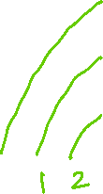


Corner Neighbors
0 | 2 | 3 | 0
0 | 0 | 4 | 0
0 | 3 | 5 | 0
2 | 0 | 9 | 0
0 | 0 | 0 | 6
🔑 sum(a)=17; sum(b)=10; sum(c) = -2
Calculate a, b, c. Pad with -1 instead of X.
A
 | C
 |  | B
A=-1
B=1
C=2
A
B
C
0 | 2 | 3 | 0 | 0 | 0 | 4 | 0 | 0 | 3 | 5 | 0 | 2 | 0 | 9 | 0 | 0 | 0 | 0 | 6
a
b
c

Slide 42
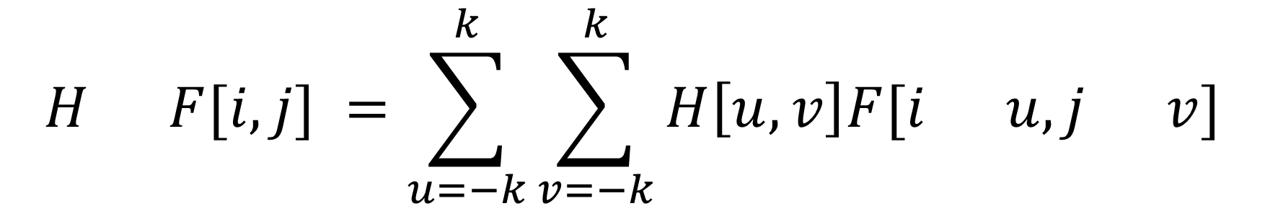
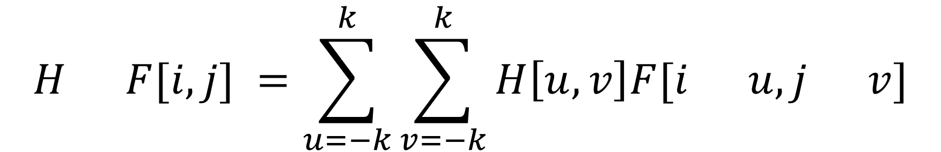
Math: Cross-Correlation vs. Convolution in 2D
$$H F[i,j] =\sum_{u=−k}^{k}{\sum_{v=−k}^{k}{H\left[u,v\right]F[i u, j v]}}$$
$$H F[i,j] =\sum_{u=−k}^{k}{\sum_{v=−k}^{k}{H\left[u,v\right]F[i u, j v]}}$$

Slide 43

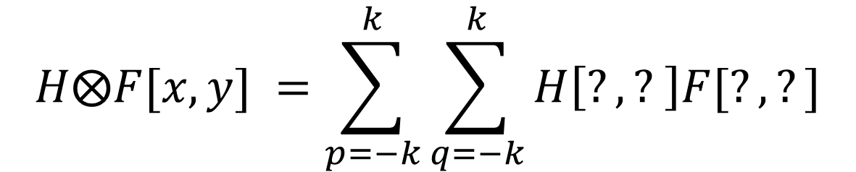



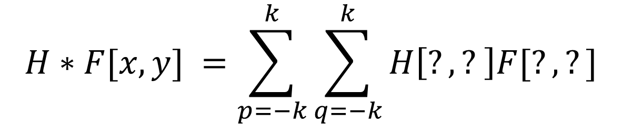
Math: Cross-Correlation vs. Convolution in 2D
Complete the equations by replacing ? with the right expressions. Adjust the sizes of the font or textbox if necessary.
$$H⨂F[x,y] =\sum_{p=−k}^{k}{\sum_{q=−k}^{k}{H\left[?,? \right]F[?,?]}}$$
$$H∗F[x,y] =\sum_{p=−k}^{k}{\sum_{q=−k}^{k}{H\left[?,? \right]F[?,?]}}$$

Slide 44
NumPy by Hand ✍️ Broadcast

Slide 45
I
0 | 1 | 2 | 3 | 4 | 5
a = I * 2

Slide 46
1D
I
0 | 1 | 2 | 3 | 4 | 5
a = I * 2
b = a + 3
c = np.ones(2)
d = b - c

Slide 47
2D
K
I
0 | 1 | 2 | 2
3 | 4 | 5 | 1
1 | 1 | 2
a = I * 2
b = a + J
c = I + K
J

Slide 48
2D
I
0 | 1 | 2
3 | 4 | 5

Slide 49

Execute by ✍️
K
c
I
0 | 1 |  | 2
3 | 2 |  | 1
3
1 | 2
a = I * 3
b = a + J
c = I - K
*
a
J
b
🔑 sum(b)=24; sum(c)=0

Slide 50
NumPy by Hand ✍️ Compare

Slide 51
L1
K
2 | 4 | 3 | 2
1 | 1 | 1 | 1
0 | 0 | 0 | 1
0
1
1
a = K – Q
b = np.abs(a)
c = np.sum(b, axis=0)
Q

Slide 52

Compute L1 ✍️
K
1 | 4 | 3 | 3
2 | 2 | 1 | 2
1
3
a = K – Q
b = np.abs(a)
c = np.sum(b, axis=0)
Q
C
🔑 sum(c)=12

Slide 53


Compute L1 ✍️
Q
C
K
1 | 3 | 1 | 2
3 | 2
1 | 1
2 | 2
a = K – Q
b = np.abs(a)
c = np.sum(b, axis=1)
🔑 sum(c)=5

Slide 54

Code with ChatGPT [Filtering]

Slide 55
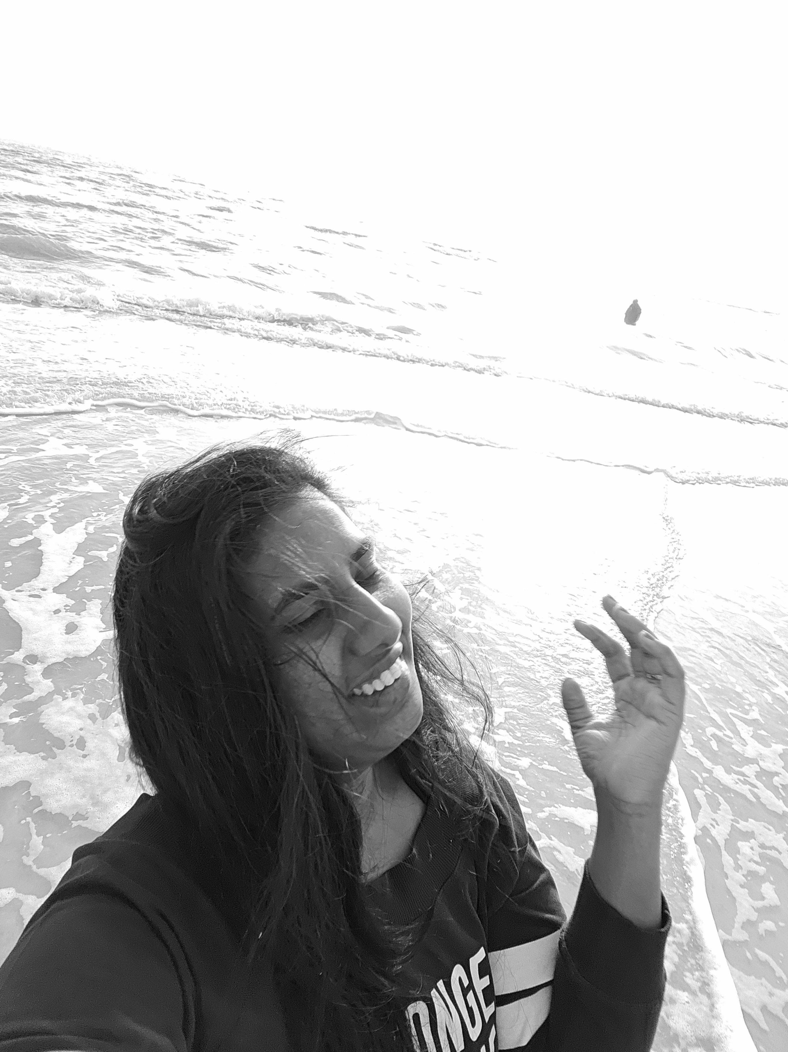
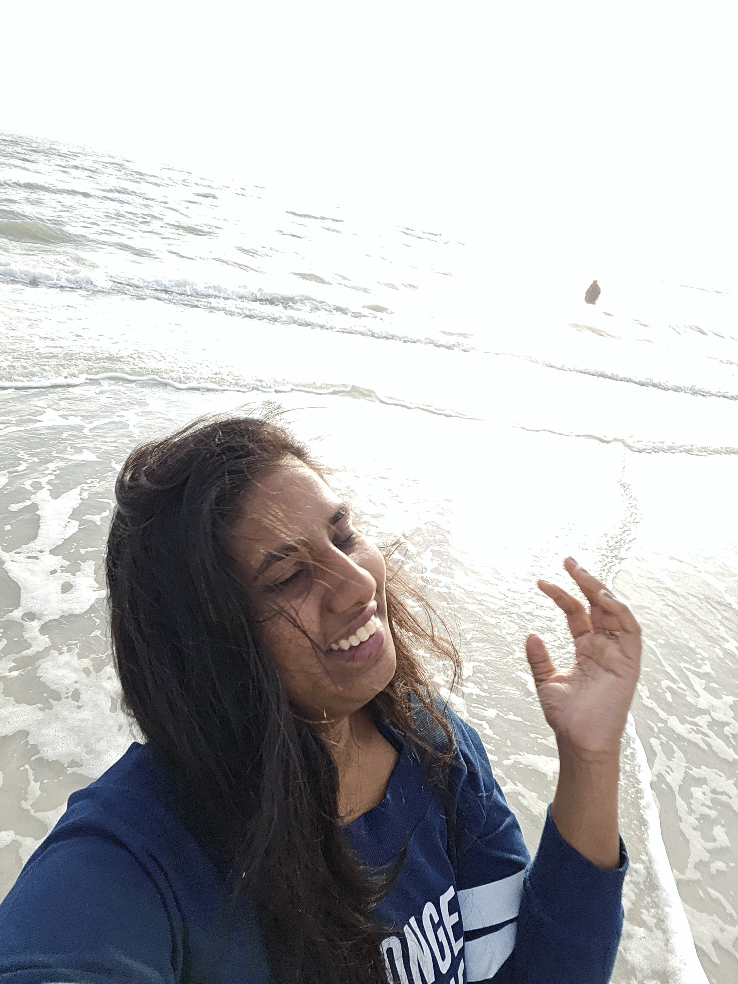

Ask ChatGPT to generate python code to convert your “travel” photo to a grayscale image. Submit the results below.
Code from ChatGPT
RGB
Grayscale
{Replace this code block, adjust the font size if necessary to fit}
import numpy as np
from PIL import Image
def flip_image_vertically(input_path, output_path):
# Open the image and convert it to a numpy array
with Image.open(input_path) as img:
img_array = np.array(img)
# Flip the image array vertically
flipped_array = np.flipud(img_array)
# Convert the flipped array back to an image
flipped_image = Image.fromarray(flipped_array)
# Save the flipped image
flipped_image.save(output_path)
# Example usage
flip_image_vertically('path/to/your/image.jpg', 'path/to/save/flipped_image.jpg’)

Slide 56
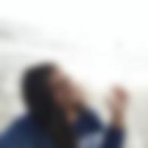


Ask ChatGPT to generate python code to resize a photo to (200,200) and apply a ”Gaussian” filter to it. Use the code to process your travel photo with kernel sizes 5 and 15. Submit the results below.
Code from ChatGPT
Kernel size = 5
Kernel size = 15
{Replace this code block, adjust the font size if necessary to fit}
import numpy as np
from PIL import Image
def flip_image_vertically(input_path, output_path):
# Open the image and convert it to a numpy array
with Image.open(input_path) as img:
img_array = np.array(img)
# Flip the image array vertically
flipped_array = np.flipud(img_array)
# Convert the flipped array back to an image
flipped_image = Image.fromarray(flipped_array)
# Save the flipped image
flipped_image.save(output_path)
# Example usage
flip_image_vertically('path/to/your/image.jpg', 'path/to/save/flipped_image.jpg’)

